Slide 1
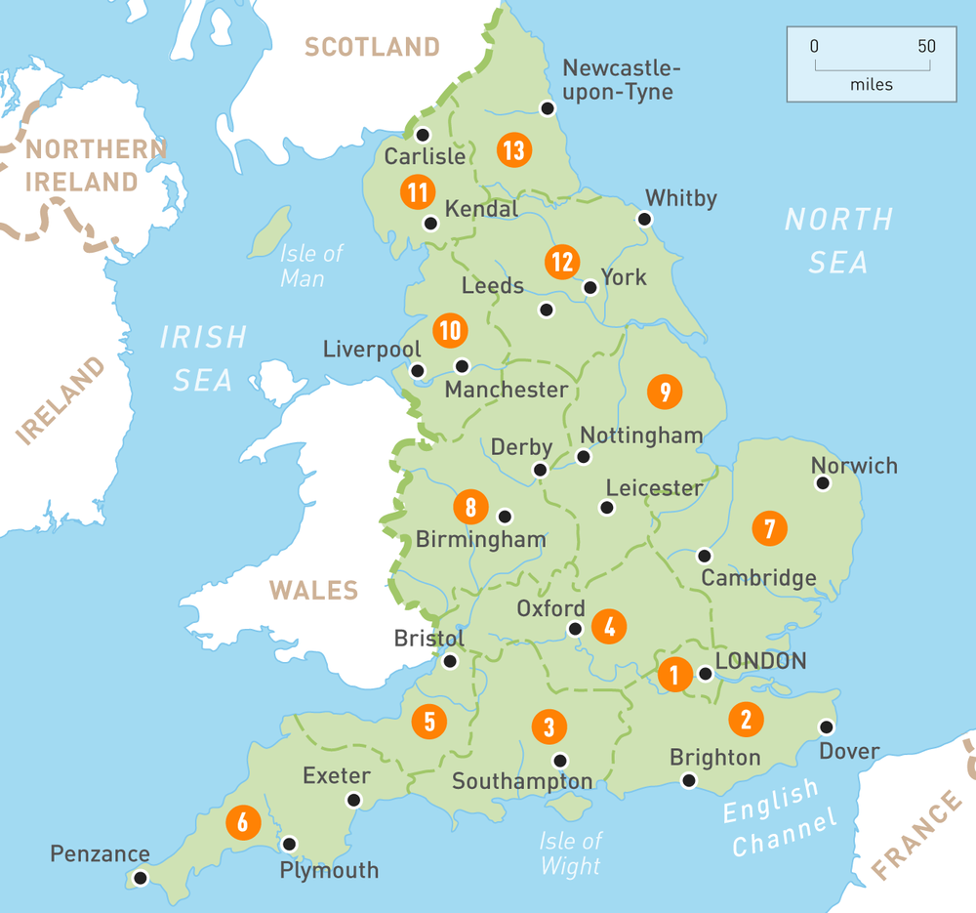
Long COVID:
Hertfordshire (shared with ME/CFS group)
Online/National (e.g., Long Covid Support charity, Asthma + Lung UK, Covid Aid, Long Covid SOS, Long Covid Kids)
Fibromyalgia
Christchurch (Dorset)
London/Ealing
Redbridge (Greater London)
Dulwich (South London)
Morden (South London)
Tring (Hertfordshire)
Milton Keynes
Medway (Kent)
South-Central England (general area)
South-East England (general area)
Greater London
Midlands (general area)
ME/CFS:
Cambridge
Norfolk & Waveney
Dorset
Gloucestershire
West Cornwall
Chiltern (Buckinghamshire/ Oxfordshire area)
Surrey
Sussex & Kent
Richmond & Kingston (Greater London)
South East London
West London
Hertfordshire
Keynsham (Bristol area)

